Slide 1

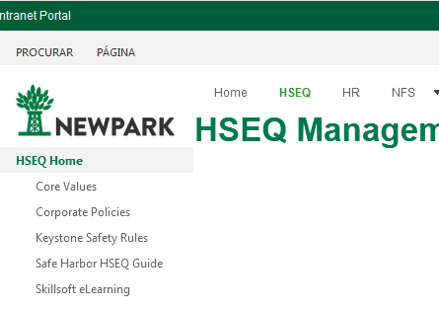
HSEQ Management System – DEV Site
The corporate structures are ok. No changes are needed

Slide 2
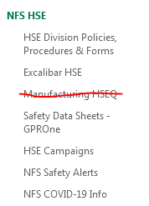
NFS HSE – DEV Site

Slide 3
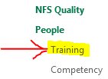
NFS Quality – People/Training
HSEQ
Technical
Other Non-Technical
Keystone Safety Rules
ISO/API QMS
Emergency Mgmt
MOC
Non-Conformances
XXX
XXX
XXX
API 13 B
XXX
XXX
XXX
XXX
XXX
XXX
XXX
Compliance
Ethics
XXX
XXX
XXX
XXX
XXX
XXX
New Hire
Onboarding
Additional
Training

Slide 4
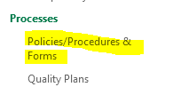
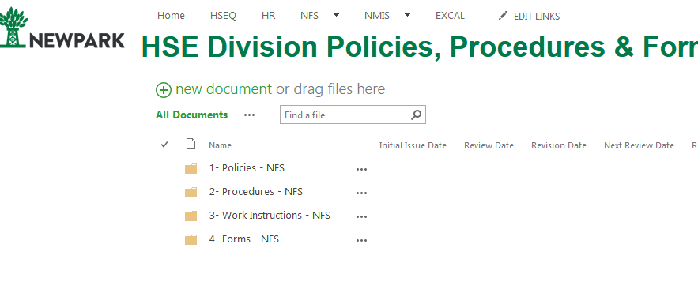
NFS Quality – Processes
Please Change the name to “Quality Division Policies/Procedures & Forms”. And create the same folders we have for HSE Division Policies, Procecedures & forms.

Slide 5
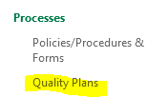

NFS Quality – Processes
GOM Offshore
International Offshore
Quality Plan
Quality Plan
US Land
Quality Plan
International Land
Quality Plan
Please add to Quality plans this mockup.
For each sub item we will send you a quality plan to be linked.
International Geothermal
Quality Plan

Slide 6
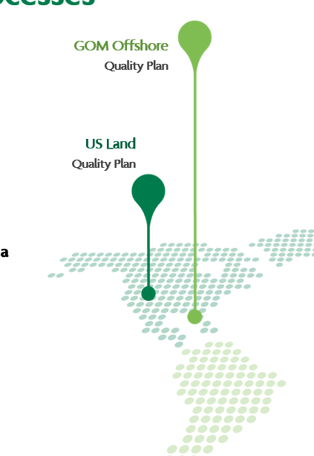
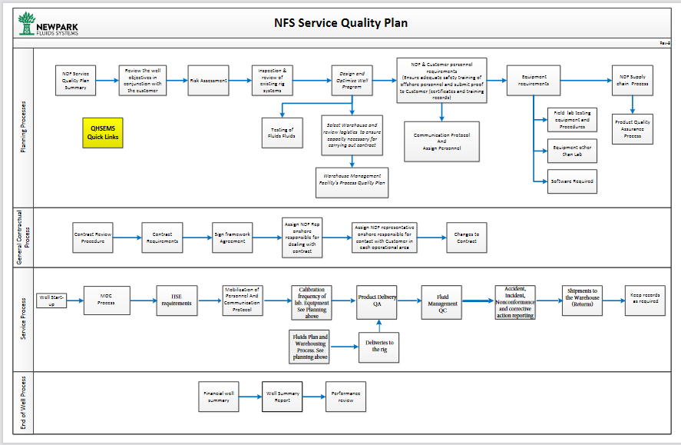
NFS Quality – Processes
For GOM Offshore, please link the Quality plan that we currently have in DEV site (below quality plan)
We will send the other quality plans in a near future

Slide 7
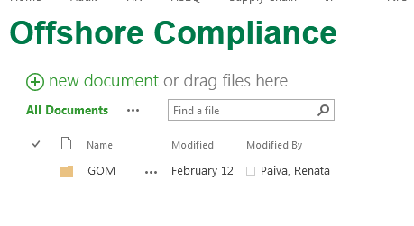
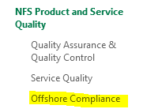
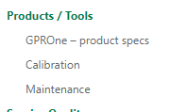
NFS Quality – Produts / Tools
Copy the information we have in PROD site for Offshore Compliance
In Products/Tools:
Keep the GPROne link
maintain Calibration and Maintenance
Add “Offshore Compliance”

Slide 8
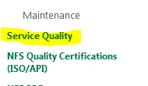
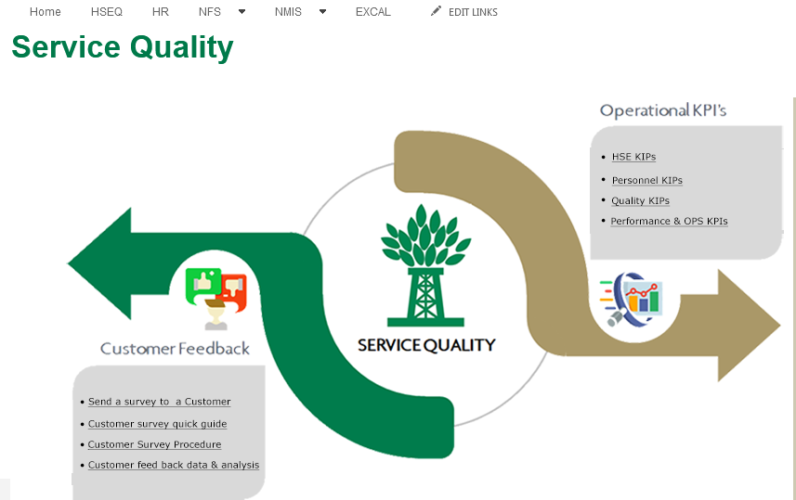
NFS Quality – Service Quality
In Service Quality:
Keep the same information

Slide 9
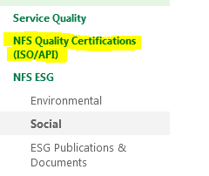
NFS Quality – NFS Quality Certification
In NFS Quality Cerfications:
I will send you na updated map

Slide 10
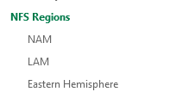
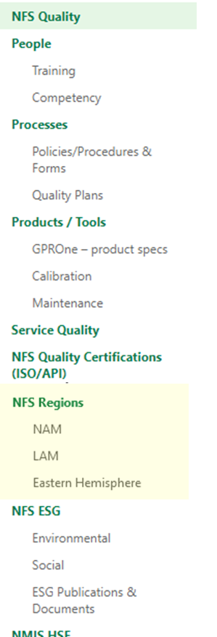
NFS Regions Home -
We keep the same Libraries
But we move the entire NFS Regions above NFS ESG

Slide 11
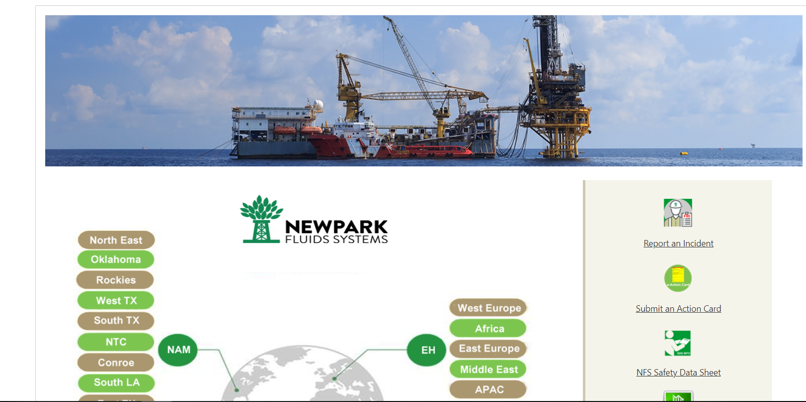
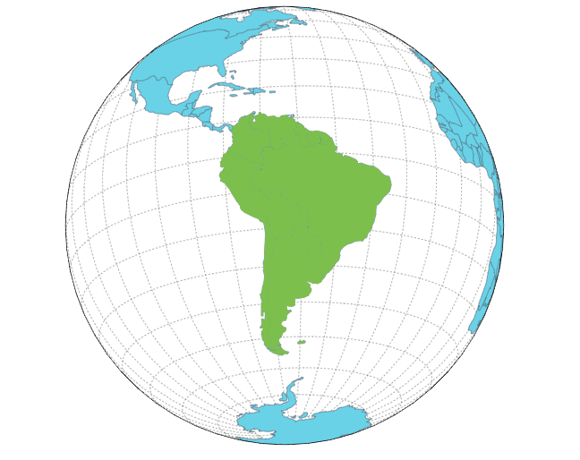
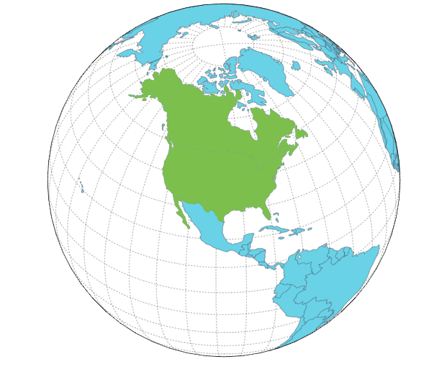

NFS Regions Home -
Replace landing page image
By this image, create links to
NAM-LAM and EH on the globes of the image
LAM
NAM
EH

Slide 12
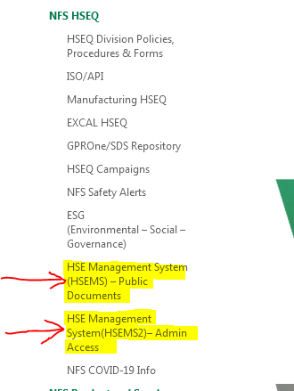
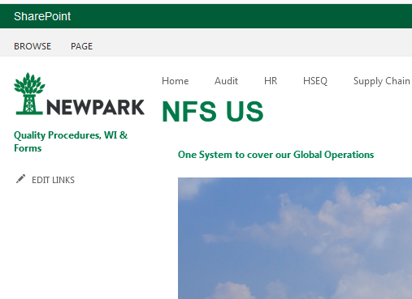
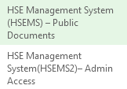

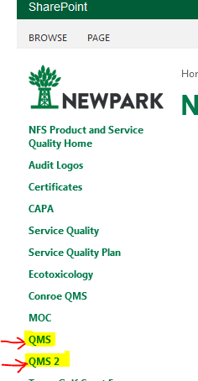
NFS Regions Home - NAM
The Libraries:
HSE Management System – Public
HSE Management System – Access
that we have in PROD site should be moved to NFS Regions – NAM/US
Add the Libraries:
HSE Management System – Public Documents
HSE Management System – Admin Access
QMS
QMS2
The Libraries:
QMS
QMS 2
that we have in PROD site, under “Quality Assurance & Quality Control” Library, should be moved to NFS Regions – NAM/US

Slide 13
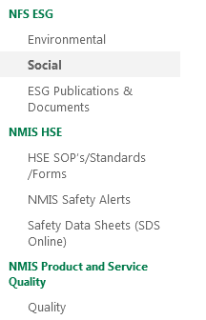
NFS ESG – NMIS HSE NMIS Product and Service
Keep the same information

